Slide 1
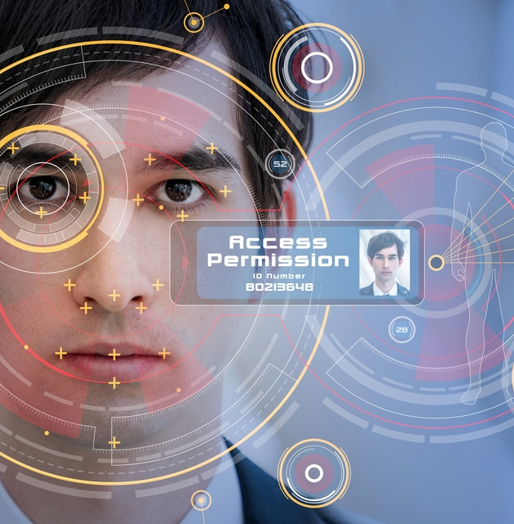
Face Recognition-Based Attendance System
BY:
S.SNIGDHA(20P61A6644)
S.SHOUMIK(20P61A6645)
S.VYSHNAVI(20P61A6646)

Slide 2
Introduction
Project Idea
Existing System
Proposed System
System Architecture
Steps & Implementation
Future Scope
Conclusion
Agenda

Slide 3
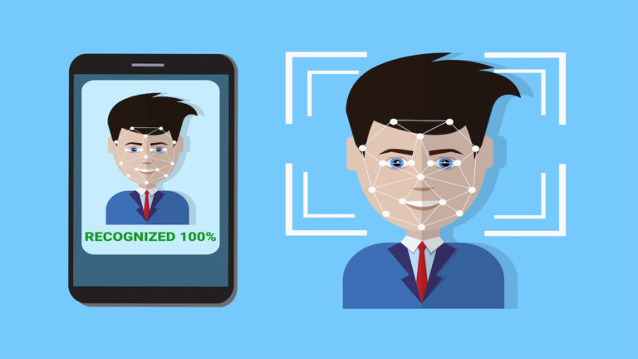
Introduction
As the technology evolves, the life style of people is changing. So that we have to adapt to the changes to be up to date with the changing technology.
One such change is the virtual meetings and these are the saviors to almost from every student to working professionals.
Earlier, every meeting is used to be physical but now they became virtual.
But, maintaining the attendance record in the virtual meetings has become a task for the host. The main aim of the project is to build attendance system specially for virtual meetings based on face recognition.
Recognizing people by their faces in pictures and video makes the work of the host simpler.

Slide 4
Project Idea
This project is being carried out due to the concerns that have been highlighted on the methods which lectures use to take attendance during lectures
Machine learning is one among the interesting domain that enables the machine to train itself by providing an appropriate output during testing by applying different learning algorithms.
Nowadays Attendance is considered as an important for both the students as well as the teacher of an educational organization.
With the advancements of the machine learning technology the machine automatically detects the attendance performance of the students and maintains a record of those collected data

Slide 5
Existing System
Different systems are being used for face recognition like attendance systemswith fingerprint scanners, RFID tags and readers, facial recognition and location-based attendance systems
SYSTEM TYPE | ADVANTAGES | DISADVANTAGES
RFID CARD SYSTEM | SIMPLE | FRAUDULENT USAAGE
FINGERPRINT SYSTEM | ACCURATE | TIME-CONSUMING
VOICE RECOGNITION SYSTEM | ------ | LESS ACCURATE COMPARED TO OTHERS
IRIS RECOGNITION SYSTEM | ACCURATE | PRIVACY INVASION

Slide 6
Proposed System
Our proposed system is an application which can capture the attendance in a virtual meeting using facial recognition.
It can detect and recognise the faces of the attendees.
At the time of enrolment, images of students are stored and recorded in a database.
In real time, video of a student present in the session will be captured.
The face will then be detected and matched with the dataset images, and roll number of the present student will be displayed along with updating the attendance.
The proposed system has many advantages over the existing systems like it can detect faces of multiple students at a time. It saves the time and effort of the host to a greater extent. There is less chance for proxy attendance through this system as it is based on real time face recognition

Slide 7
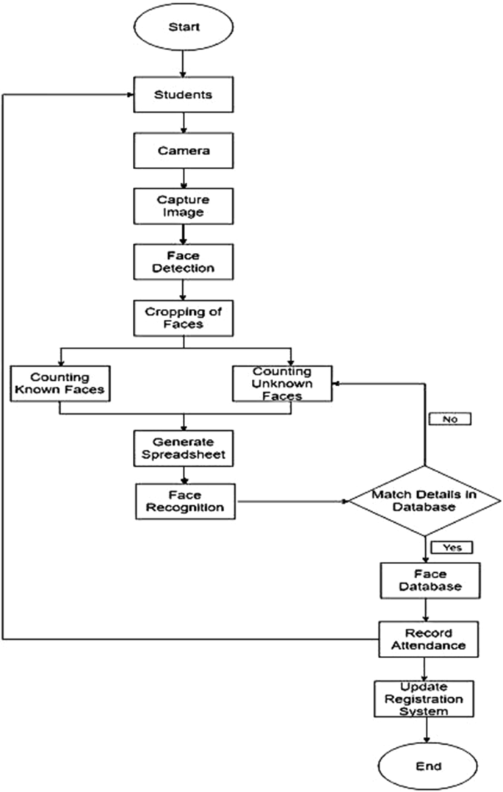
System Architecture

Slide 8
Working Steps
Step -1:We are importing the required libraries.
Step-2:Defining the Flask App.
Step-3:Functions that return today’s date strings to use in the program ahead.
Step-4:Initializing Video Capture object to access Webcam.
Checking if the required folders are in place or not, If not create them.
Step-5:Define Functions
A function that calculates the number of total registered users.
A function that extracts the face from an image.
A function that Identifies face using ML model.
A function that trains the model on all the faces available in the faces folder.
A function that extracts info from today’s attendance file in the attendance folder.
A function that adds the Attendance of a specific user in our today’s Attendance file.

Slide 9
Step-6 : Define main page routing function.
This function will run when we click on Take Attendance Button.
This function will run when we add a new user.
Our main function which runs the Flask App.

Slide 10
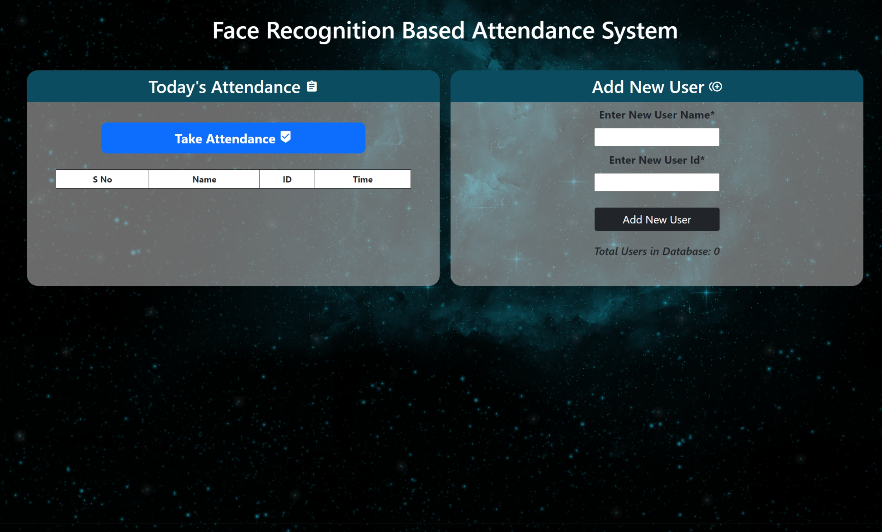
Implementation
Main Screen

Slide 11
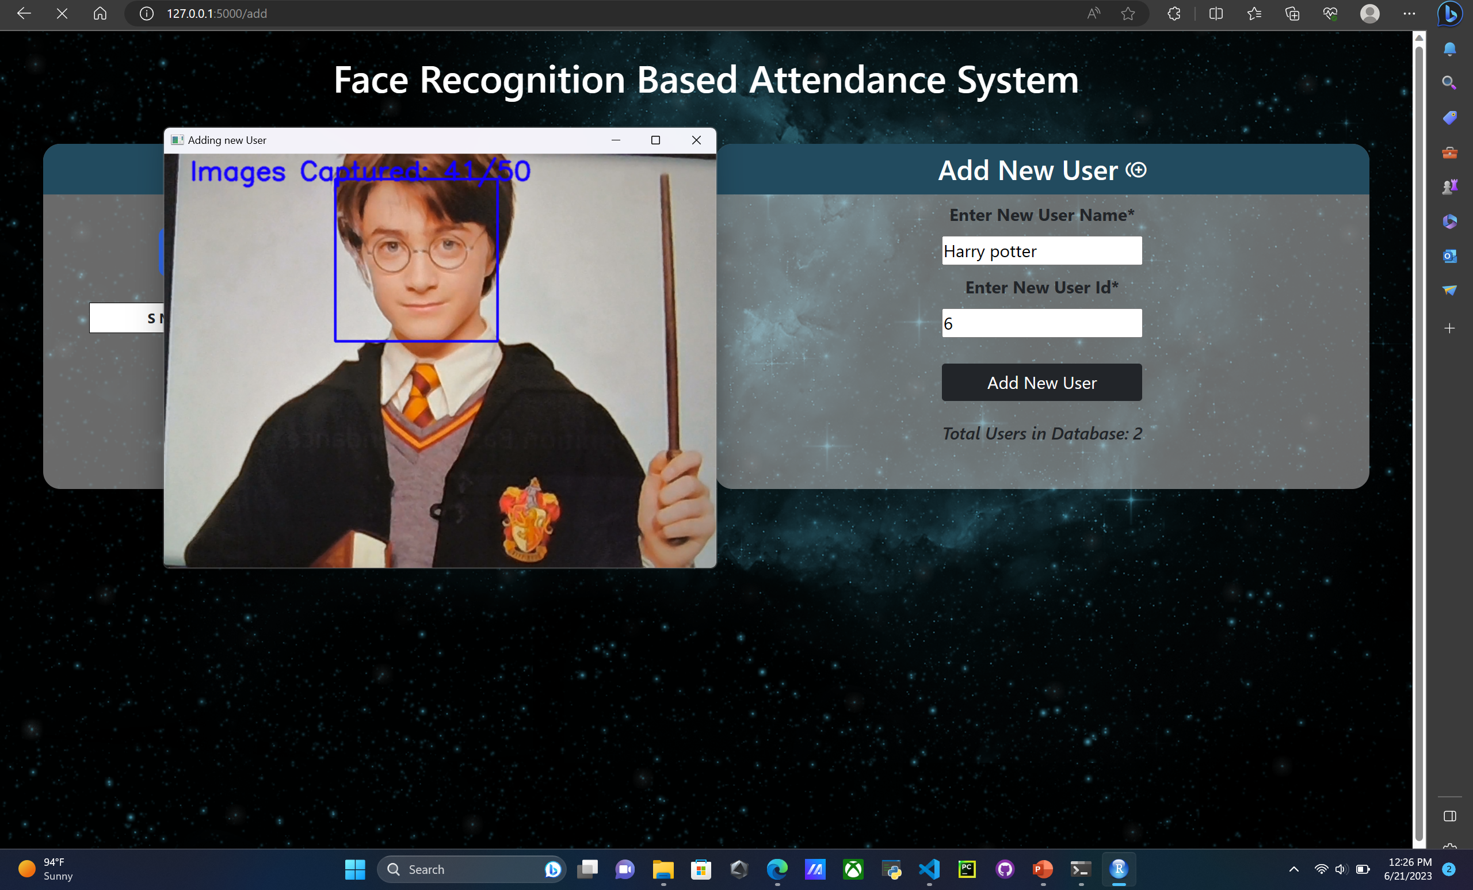
Step-1:Enter Username & ID

Slide 12
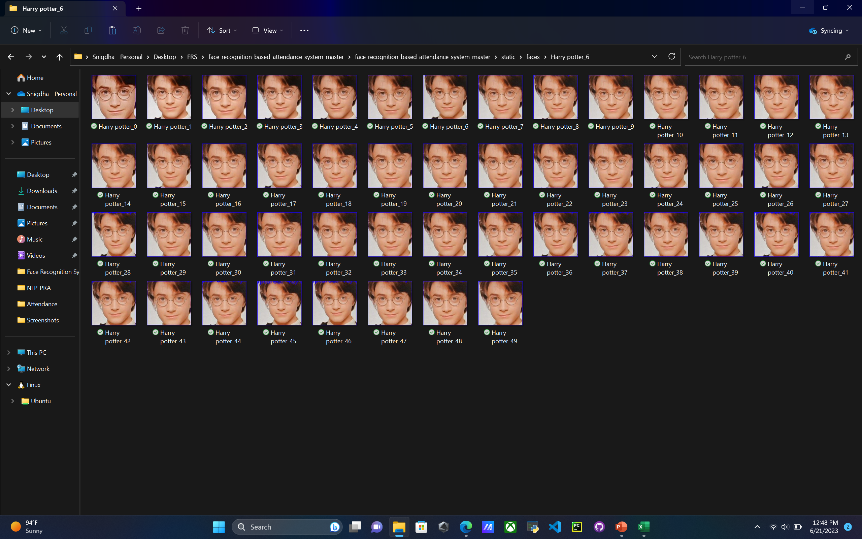
Step-2:Faces Captured in Static Folder

Slide 13
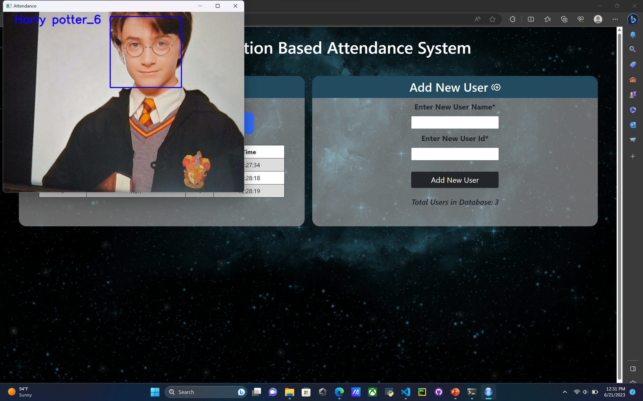
Step-3:Taking Attendance

Slide 14
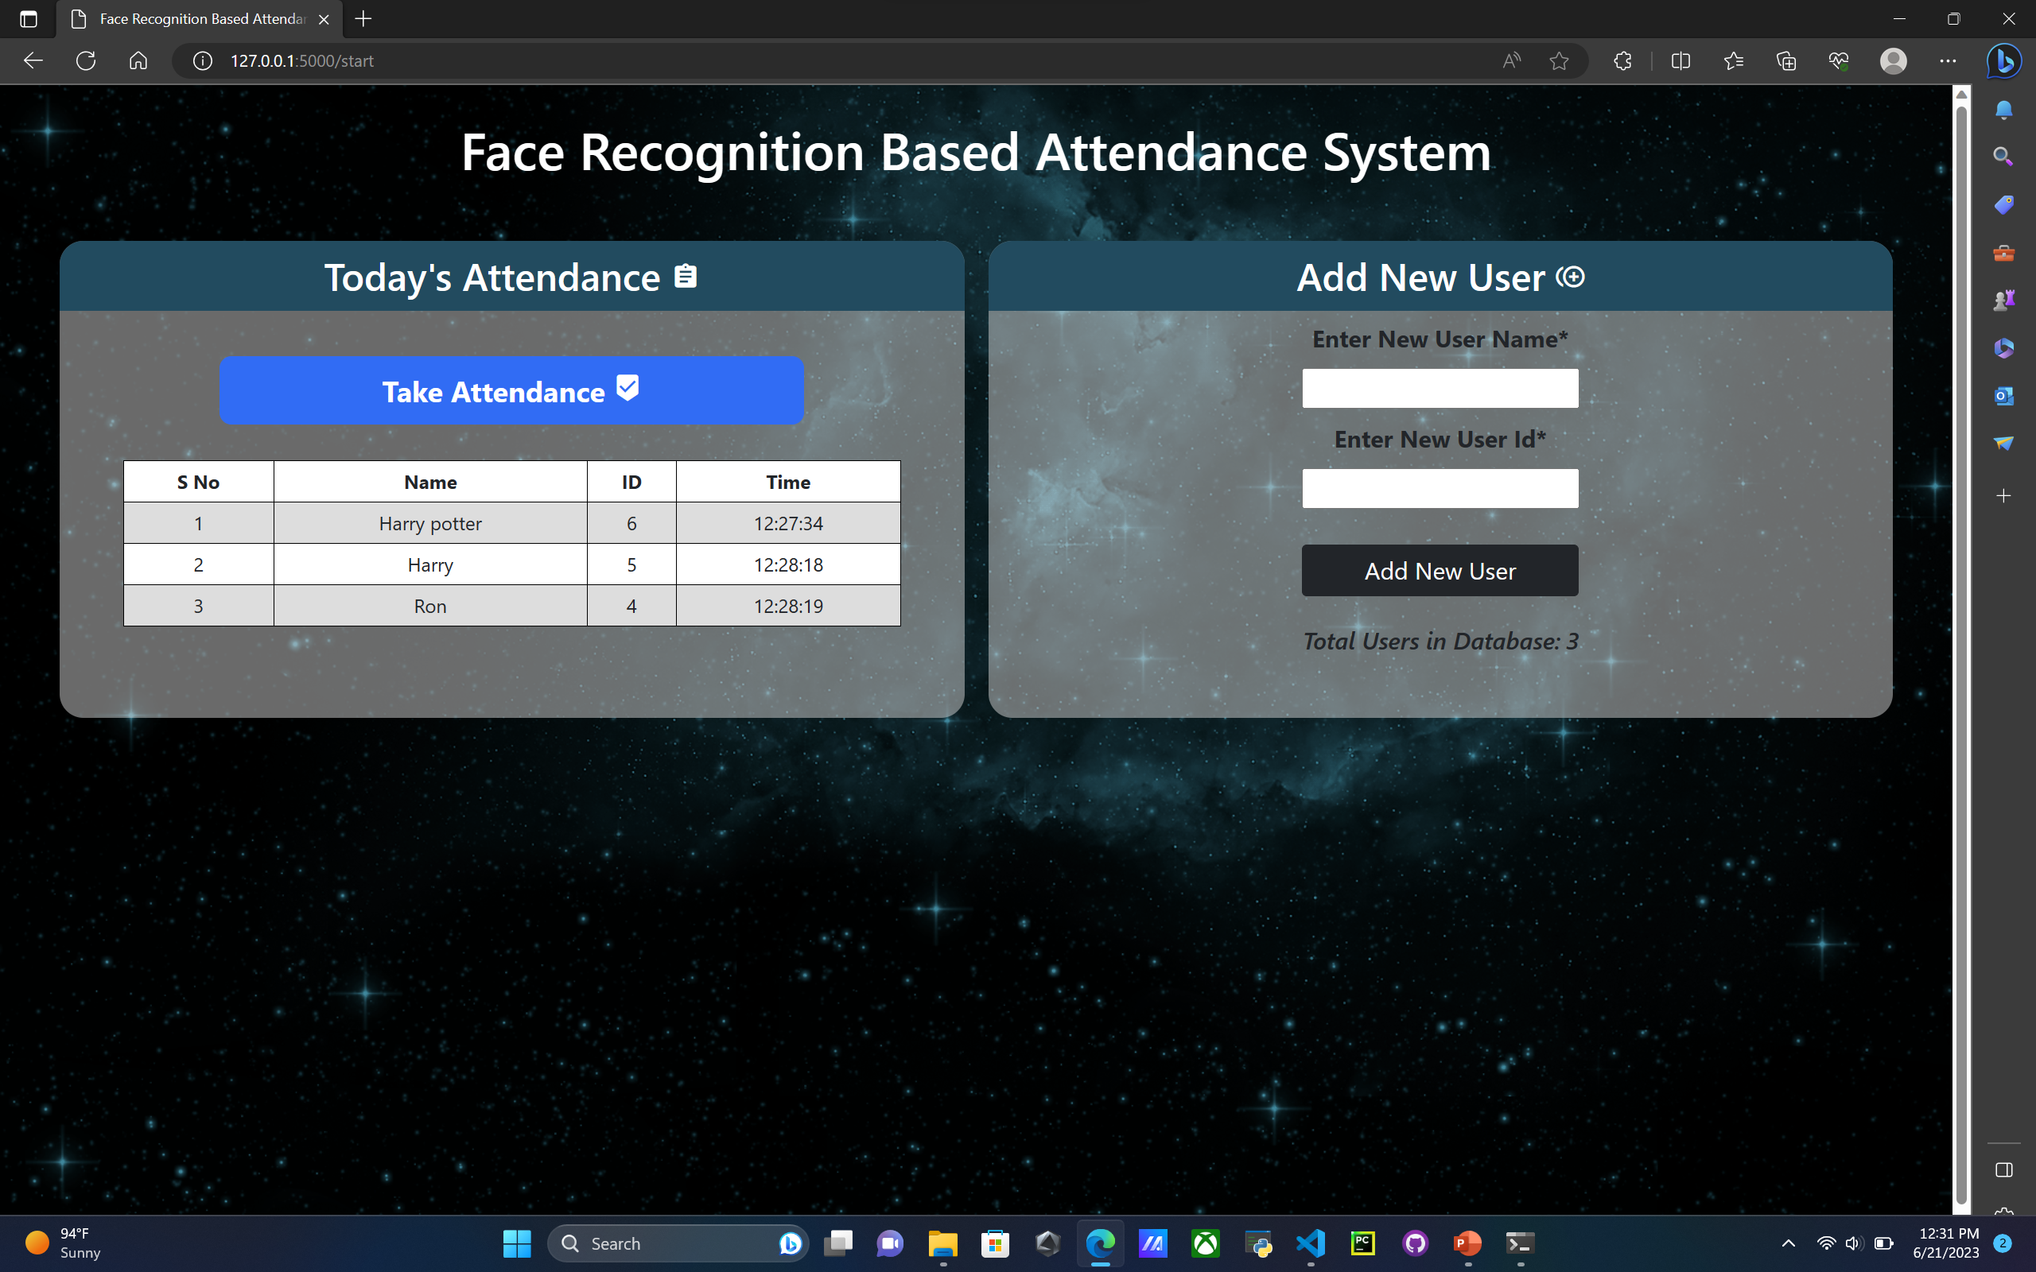
Step-4:Showing Attendance taken:

Slide 15
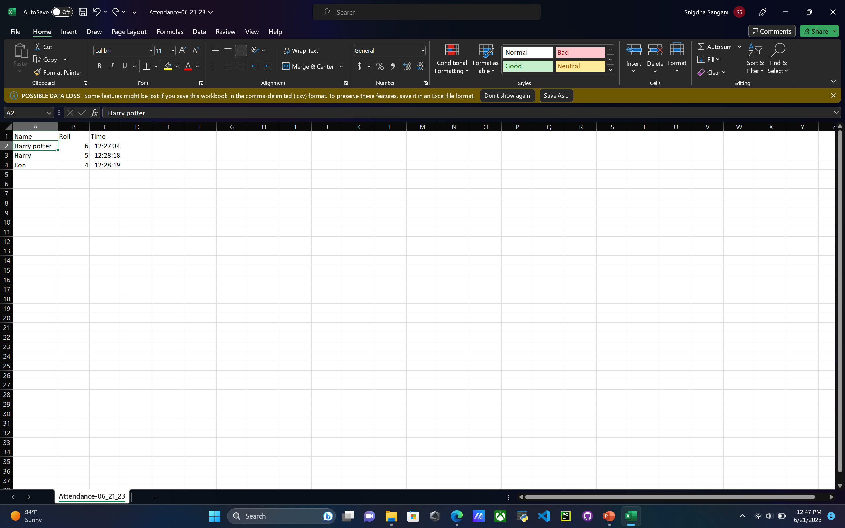
Step-5:Attendance Sheet

Slide 16
Future Scope
Besides, we can simplify the system and make more efficient by taking advantage of multiple face detections to mark attendance of all the visible faces in single attempt.
This will be economical and more efficient use of face recognition for attendance marking.
We also consider to develop an android application for this system in near future

Slide 17
Conclusion
Thus, the aim of our project is to capture the images of the students, convert it into frames.
Relate it with the database to ensure their presence or absence, mark attendance to the particular student to maintain the record.
The Automated face Recognition Attendance System helps in increasing the accuracy and speed ultimately achieve the high-precision real- time attendance to meet the need for automatic classroom evaluation.
This system is designed to minimize the human effort for taking the attendance manually that take place in every college.
As the attendance marking process is done without any human interference, which is the main scope in the system.

Slide 18
THANK YOU

